Slide 1
RAM1
DWT
RAM2
DWT
RAM1

Slide 2
DRAM
DMA
AXI
AXI4-Stream
PS
(SDK)
PL
IF
FIFO
Memory0
65536*10
OF
FIFO
8
Quantization
DWT Filter
Data compression
(Huffman Coding)
SD Card
AXI4 Lite
16
Difference
Memory1
65536*10

Slide 3
L
H
LL
HL
Row Convolution
Column Convolution
LH
HH
h
LL
h
g
LH
Gray Image
h
HL
g
g
HH
Low-Pass Filter
High-Pass Filter

Slide 4
-3
-2
-1
0
1
2
3

Slide 6
Top Module
AXI4-Lite Module
Slave AXI4-Stream
Module
Image Compress Module
Master AXI4-Stream
Module
Input FIFO
Module
Output FIFO
Module
DWT
Module
Quantization&
Difference
&
Huffman Coding
Module
BRAM
BRAM

Slide 7
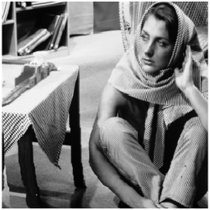

Original image
Image after compression and decoder

Slide 8
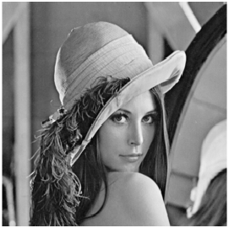

Original image
Image after compression and decoder

Slide 9
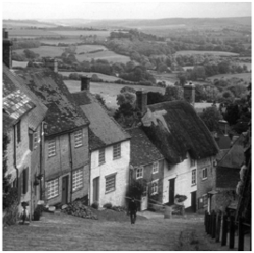

Original image
Image after compression and decoder

Slide 10
